Slide 1
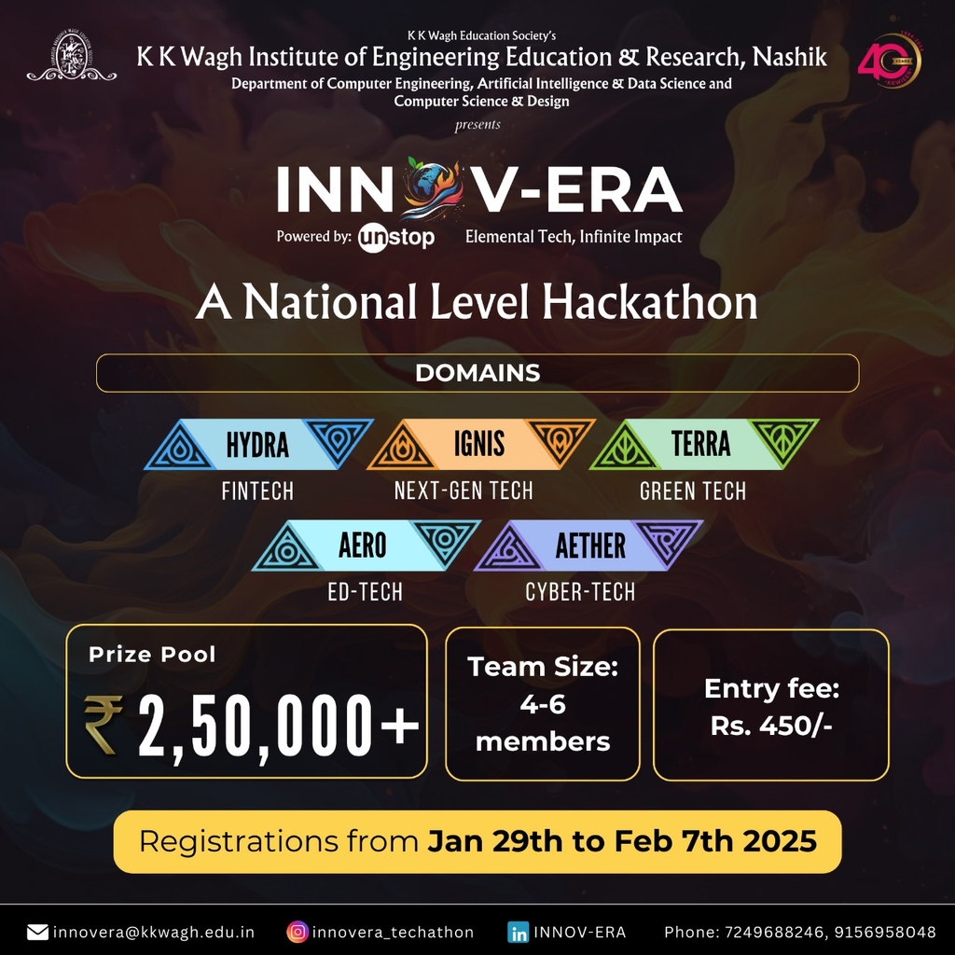

Welcome
By Team : Quantum Cultivators

Slide 2
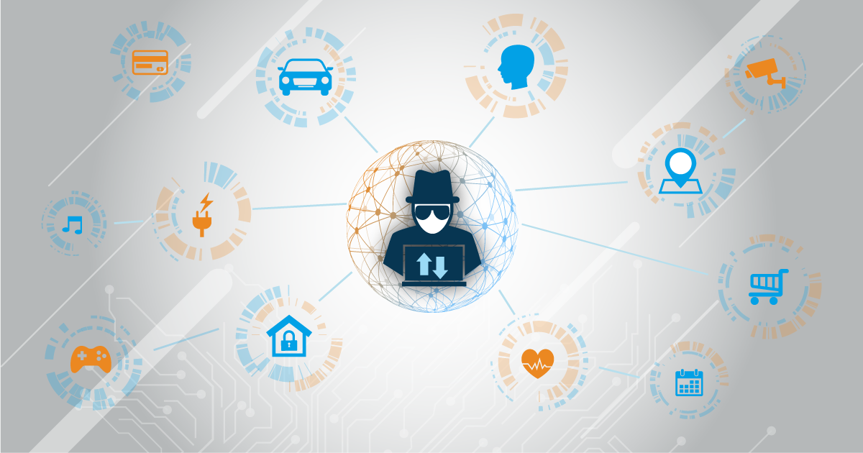
Introduction
NetraAI
Voicea
NetraAI is an AI-powered assistive tool for the visually impaired, enabling scene understanding and facial recognition.
Uses Raspberry Pi with a USB camera for efficient visual data capture and processing.
Powered by Google’s Gemini 1.5 Pro, it provides accurate image analysis and real-time auditory feedback for enhanced accessibility.
Voicea is an educational platform that enhances accessibility through voice-based features:
Learning & Reading – Narrated video lectures and text-to-speech BookReader.
Community & Notes – Voice-based Q&A forum and spoken-word note capture.
Interactive Quizzes – Audio-based questions with voice or touch responses.

Slide 3
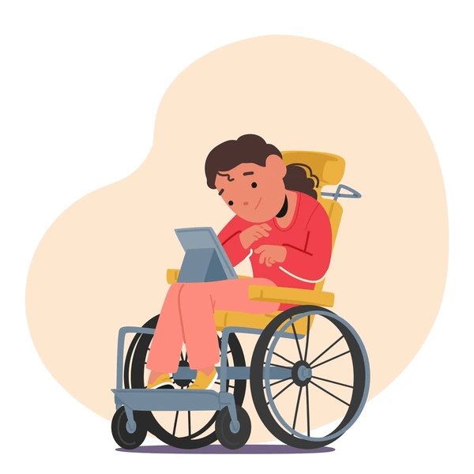
NETRA AI
Problem 01
Problem 02
Problem 03
Problems
Integrating Hardware with Software
Model Training
Selecting Microcontroller for cost cutting
Voice A
Problem 01
Problem 02
Problem 03
One-to-one comummuni-
cation
Providing Quizes for user engagement
Teacher to control video for other students

Slide 4
HOW WE MADE IT POSSIBLE ?
Use the Headset for audio output and conversion of text to speech for visually impared person
Make the model train fast and reliable to use in low light for accuracy
Using ESP32 for making low cost model
NETRA AI
Asking Question through audio and retrieving it also through audio output
Audio based Quiz for visually impaired people
Giving Admin power to the teaher for accessing students platform to play videos
Voice A

Slide 5






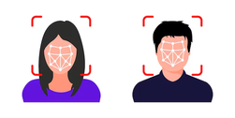


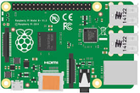
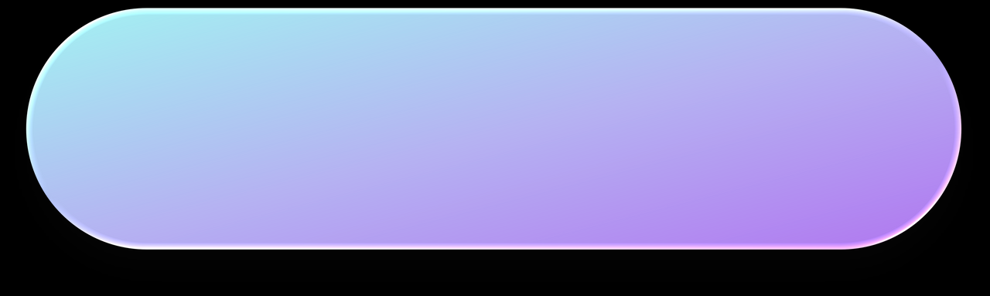
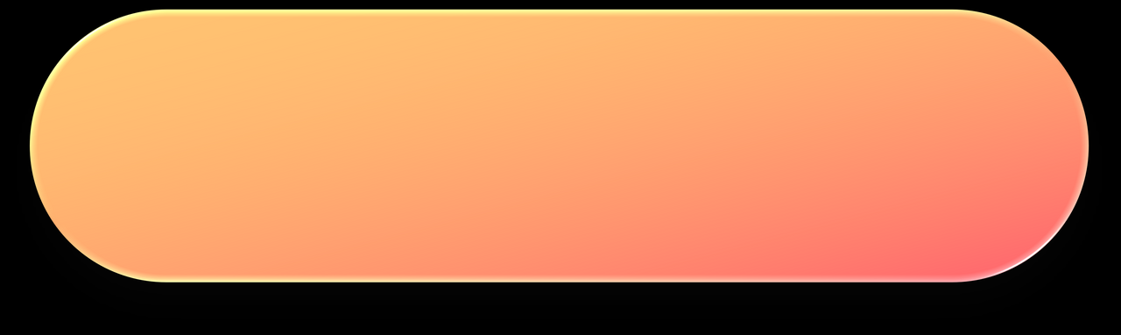

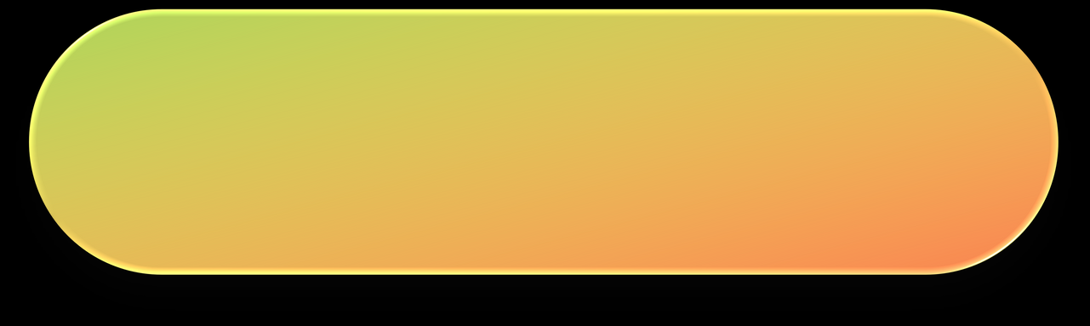






Architectural Flow Diagram for NETRA AI
IoT Device - Blind Assistance
Preprocessing
User Interaction
User Pressed Button
Capture Image
Base 64 Format
If Face
Matched
Identify Person
Using Recognition
using Open CV
Database
Name of the person
is called
Button 1
Button 2
Button 3
Button 4
Rasberry PI
If Face
Not Matched
Long Press
Capture
Image
+
Train
Model
Recognize
Face
Image
Description
Video
Description
Step 1 : Harcascade to detect face
[Pretrain ML Model for face detection]
Step 2: Convert to Grayscale
Resend it to
Preprocessing
Send Emergency
Alerts
Step 1: Go to LBPH
[Face Texture detection]
Step 2: Save the Model
Output
Capture Image

Slide 6





Architectural Flow Diagram for Voice A
User
Audio-Based
Chatbot for image
Student
Teacher
} {
View
Video
View
Quiz
Book
Reader
Note-
Making
View
Marks
Upload
Video
Upload
Quiz
Answering
Questions
Database
Server

Slide 7

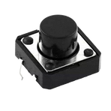


VoiceA
NETRA AI
Video Lectures 🎥📚
01
01
Face Recognition with Real-Time Toggle
Doubts - Community Discussion Forum 🗣️💬
02
02
Image and Video Description
BookReader 📖🔊
03
FEATURES
03
Tactile Button Controls
04
04
Audio Feedback via Google TTS
Voice Note Taker 🎙️✍️
05
05
Emergency Alerts for user
Quiz 🎤📝

Slide 8
Future Scope :
NetraAI
Voicea
Multi-Lingual Support
Audio Control Device
Reduce Recognition Time
Provide Sign Language for users
Full control using voice
Multi-Lingual Support

Slide 9


